Slide 1
Programming The Hardware

Slide 2
Take Care of the Equipment
The remote and FCB are loaned to you.
Take care of them!!!
If you break them, you must pay for their replacement/repair.
If you want to build your own remote, talk to me.

Slide 3
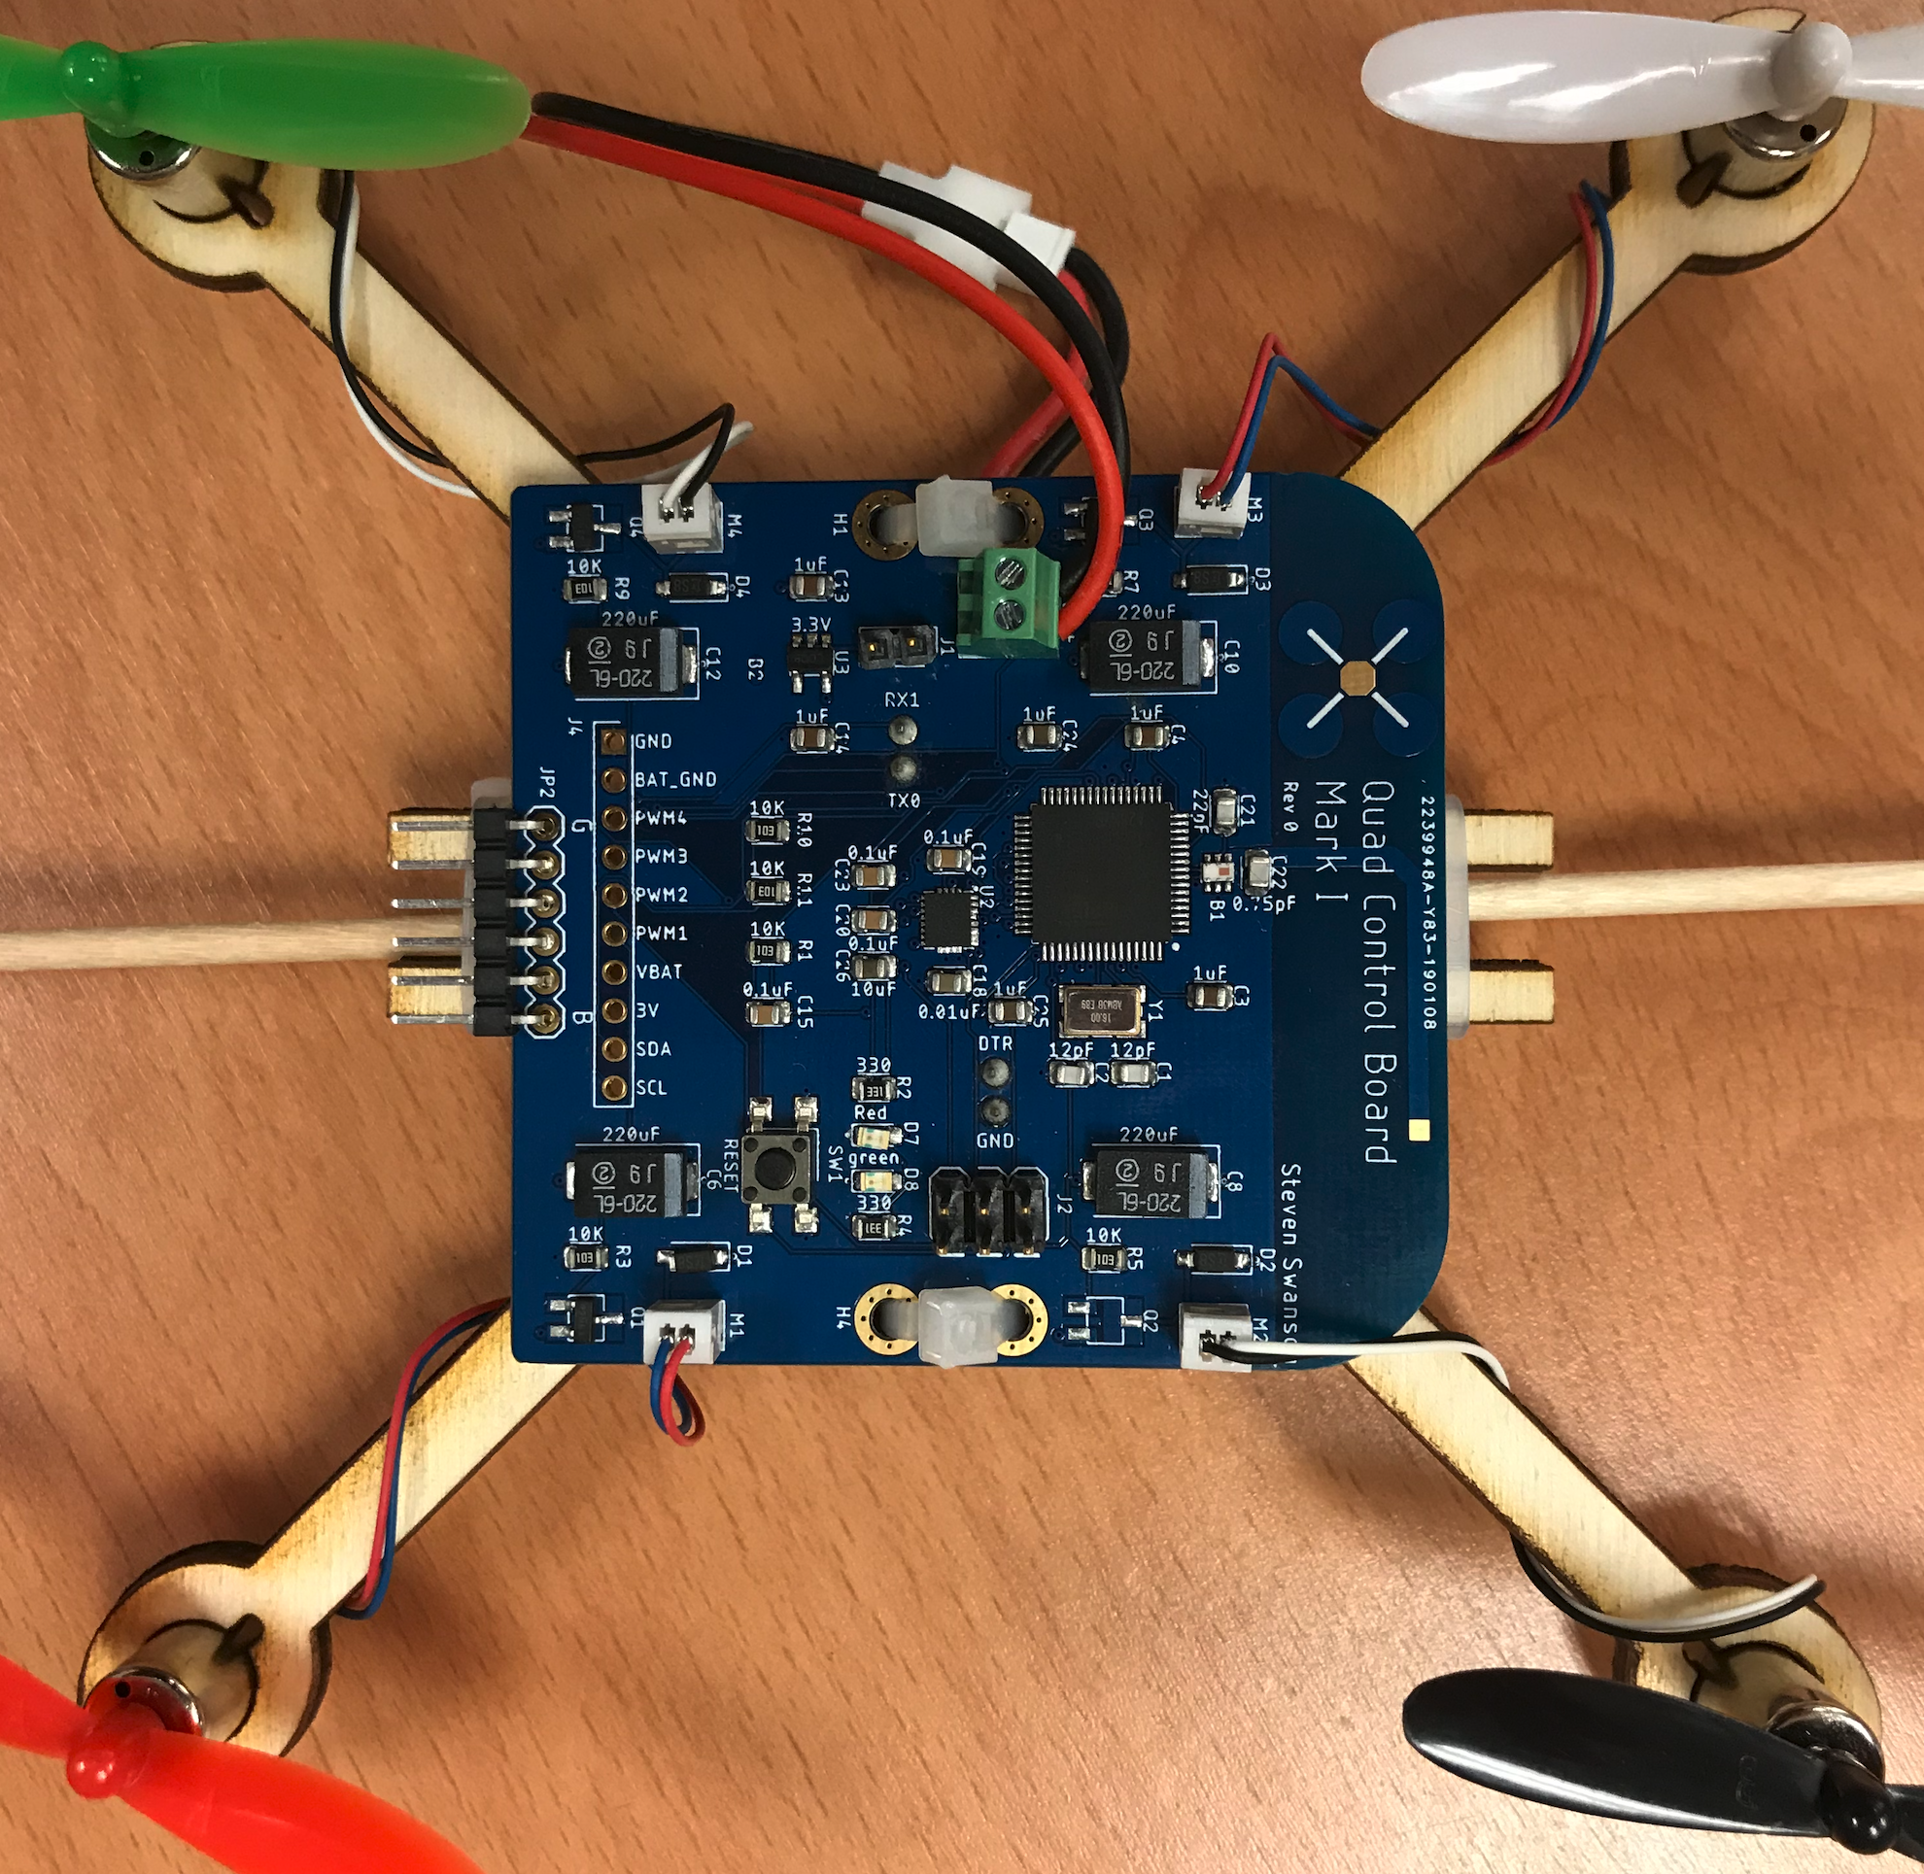
The Flight Control Board

Slide 4
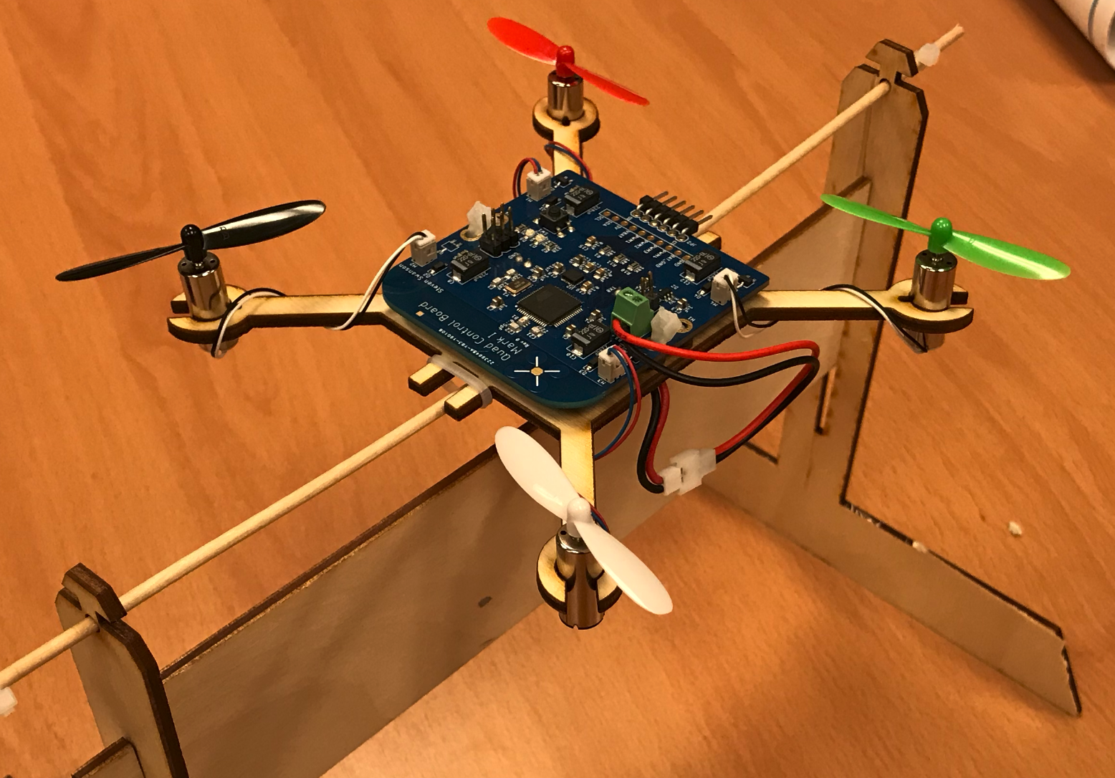
The Test Stand

Slide 5
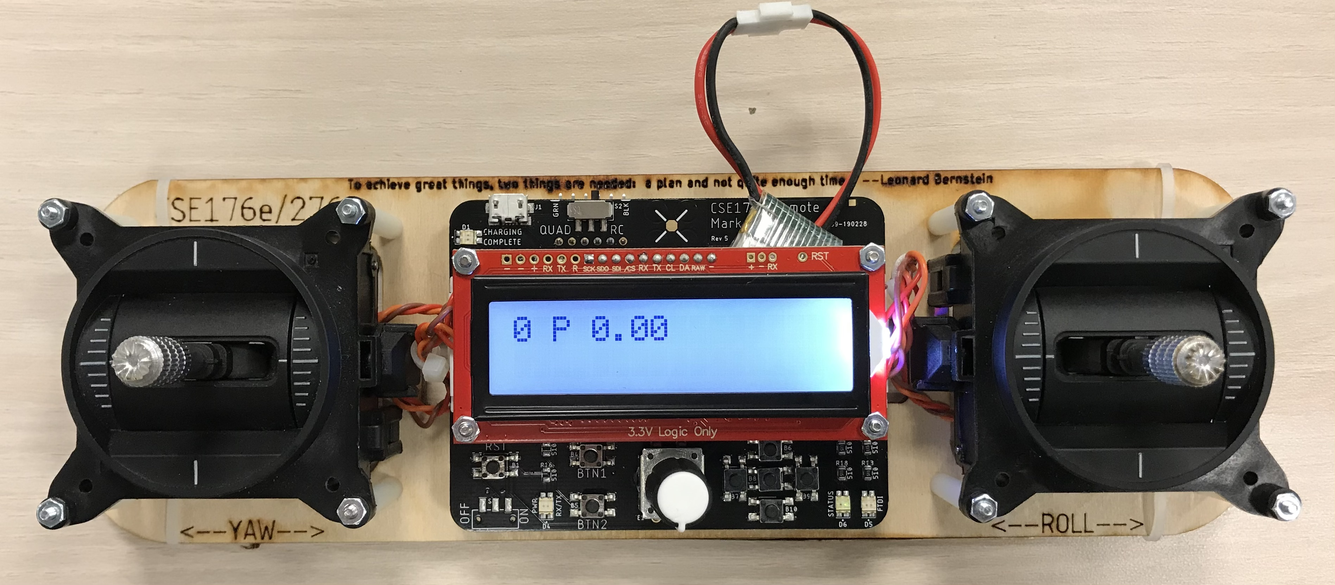
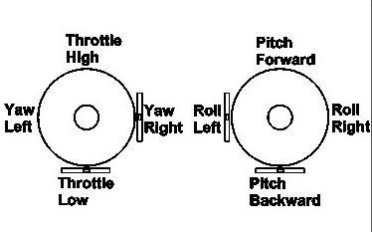
Controller
Read user input for flight
2 ”gimbals”
Left: throttle and yaw
Right: pitch and roll
Yaw, pitch, and roll are spring-loaded to return to neutral
Throttle stays where you put it.
Buttons and a knob for tuning
A radio for communication
A battery charger

Slide 6
Programming the Remote and FCB
The remote has a built-in FTDI USB-serial converter that works with Arduino.
It has two modes
RC mode – programs the remote
Quad mode – Sends programming signals via header.
To program FCB
Connect FCB to remote with 6-strand cable
Match ‘B’ to black wire and ‘G’ to green wire.

Slide 7
Powering the FCB
The FCB has two potential power sources
Battery
Power over it’s FTDI header (from remote)
There’s a two-pin jumper that disconnects the batteries. This is the on/off ’switch’.
You can run the MCU and IMU without the battery, if the FTDI port is connected.
The FCB runs through batteries quickly
Keep your remote plugged in and charging.
Swap when FCB battery get low (i.e., it starts resetting when you turn on the motors)

Slide 8
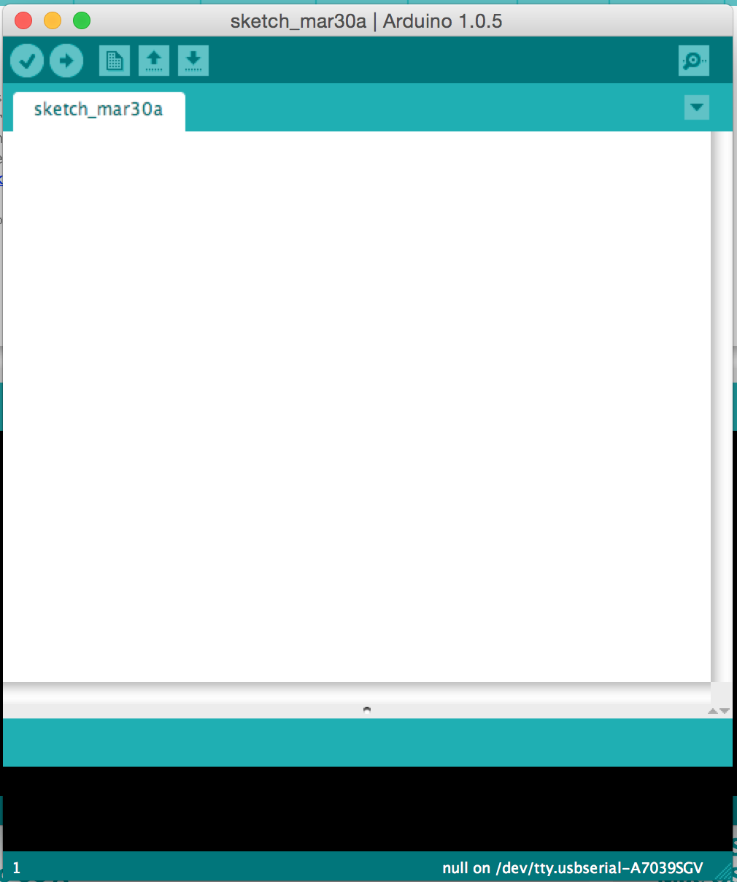
The Arduino IDE
User-friendly IDE for Arduino programming
Programming the microcontroller is easy
Installation is easy
Settings
Tools->Board->Quad Class Atmega…
Tools->programmer->USBTinyISP
Tools->Port->Com n (windows, choose largest n available)
Tools->Port->cu… (pick the one that appeared when you plugged in the remote)

Slide 9
Software Plan
This Lab
Meet the hardware
Learn to use it
Sensing Lab -- IMU Filtering
PID Lab -- Implement control
Do everything on the Test Stand first, then move to your quadcopter

Slide 10
Quadcopter Firmware
Sensing
Use the IMU to measure the orientation of the quadcopter
Filter IMU readings to eliminate noise
Control
Based on IMU measurements, maintain stability
Receive commands from remote
Implement them

Slide 11
Remote Firmware
Control
Measure gimbal position
Transmit readings to the quadcopter
Tuning
Your control algorithm will have many parameters
You’ll need to tune them in real time
Use the knob and buttons to make this easy – or don’t…

Slide 12
Lab Tasks
Use everything
Install IMU library. Read values from IMU.
Read the values from the gimbals.
Drive the motors.
Read values from the knob and buttons.
Build remote-controlled motors
FCB drives motors.
Remote control reads gimbals and transmits value to run motor at.
This is the basic framework for your quadcopter and remote firmware.

Slide 13
The Hardware

Slide 14
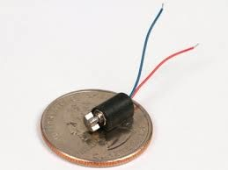
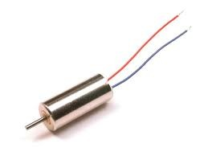
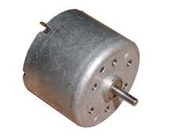
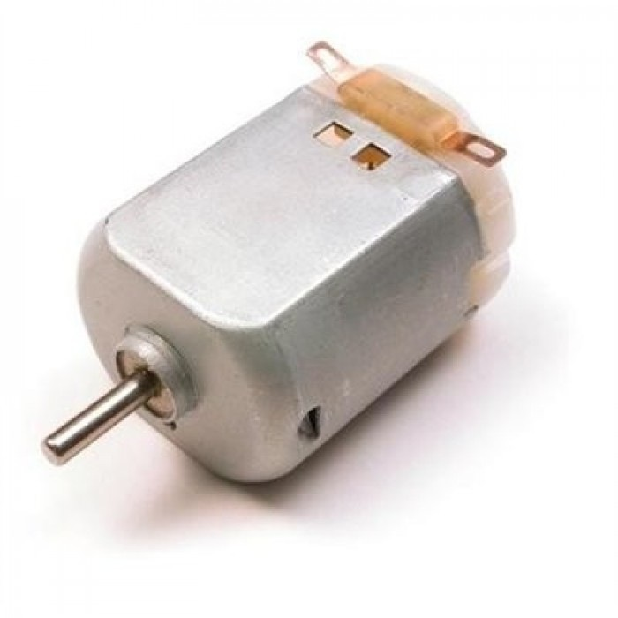
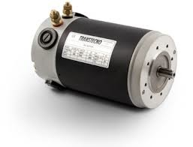
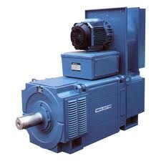
Brushed Motors

Slide 15
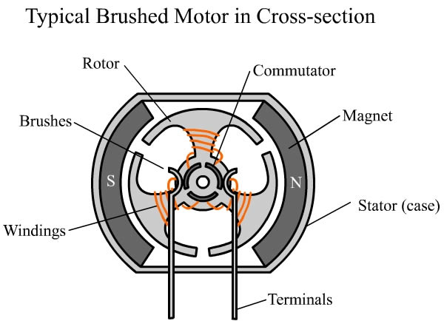
Construction

Slide 16
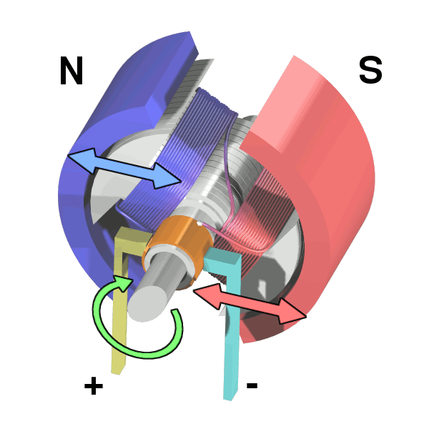
Operation

Slide 17
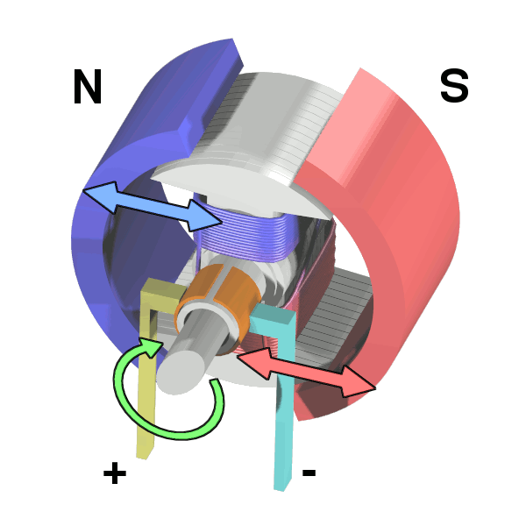
Operation

Slide 18
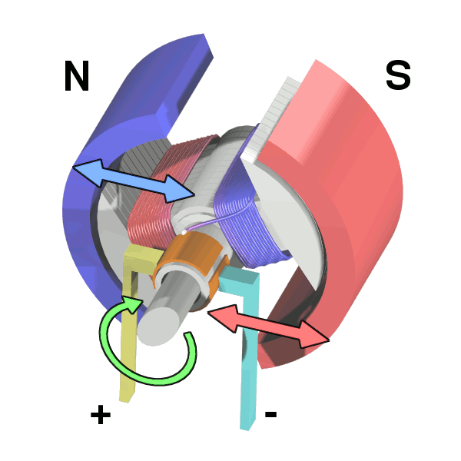
Operation

Slide 19
Operation

Slide 20
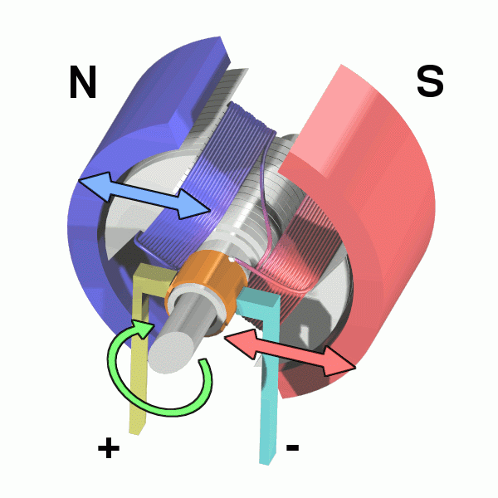
Operation

Slide 21
Controling Brushed Motors
Speed ∝ Voltage ∝ Current
Vary the input voltage
Generating varying voltages is non-trivial
You need an digital-to-analog converter
Really, we just need the average voltage to vary

Slide 22
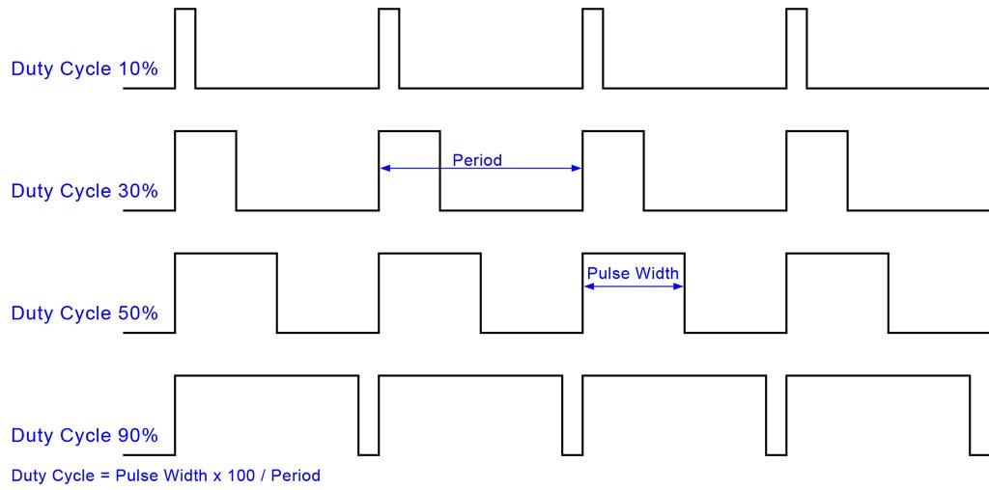
Pulse-width Modulation (PWM)

Slide 23
PWM in Arduino
The motors are connected to the FCB via analog output (PWM) pins
analogWrite (int pin, int v)
‘v’ is the duty cycle (0…255)
‘pin’ is the the pin

Slide 24
Gimbals

Slide 25
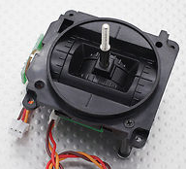
The Gimbals
Each stick is a “gimbal”
a mechanism, typically consisting of rings pivoted at right angles

Slide 26
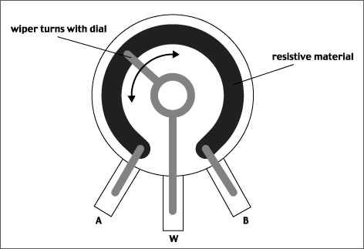
Anatomy of a Gimbal
Two potentiometers measure X and Y movement of the stick.
Potentiometer – A variable voltage divider
As the slider’s movement changes the resistance from A and W and W and B.
The voltage at W is proportional to the position of the gimbal.
In reality, the resistances are always > 0, so W never reaches VCC or GND.
Our gimbal
Frsky PR10
Total resistance: 2.4KOhms
Rated voltage: 5V

Slide 27
Reading the Gimbals
The gimbals are connected to analog input pins on the MCU
analogRead(int pin)
Takes a voltage between GND and Vcc and maps it to 0—1024
The Remote library defines constants for which pins to read.
firmware/libraries/Remote/quad_remote.h

Slide 28
Status LEDs
The remote has 2 status LEDs
They are useful for letting you know when the quad is armed, etc.
Use digital_write() to control them.
See quad_remote.h for pins

Slide 29
Buttons
The remote has 7 buttons.
1 ”D-pad” – up, down, left, right, center
2 others (btn1, btn2)
The Remote library has two interfaces
Call-backs: A function that is called when a button is pressed.
is_pressed(): Check if a button is currently pressed.
Potential problems
Some times one press appears as several due to “bouncing”

Slide 30
Rotary Encoder
The knob is ‘rotary encoder’
It can turn indefinitely in either direction.
The Remote library tracks it’s movement
Query current value with: knob1.getCurrentPos ()
Set current value with: knob1.setCurrentPos()
The software is a little buggy – some times misses movement.
The knob also has a builtin button. It works just like the others.

Slide 31
Radio
The remote and FCB (and your quadcopter) all use the same radio.
The ‘Radio’ library provides access.
There are 11 channels
Eaglint will allocate your team a channel when you create your group.
It’s not private, so you must share nicely.
Set your channel with: rfBegin(WIRELESS_CHANNEL);
Send data with: rfWrite(<data>)
Receive data (if available) with : rfRead(<data>)

Slide 32
Radio: What To Send
You must define the packet format for your remote/quad.
The easiest thing to do is define a struct that has everything you need.
It can be up to 128 bytes (I think)
You must send the data you need
You must reject packets from other sources (noise and other teams)
Include a ‘magic number’, unique to your team
Include a checksum (if you like)
Always check the length of the data you read (it should match the size of your struct)

Slide 33
Remote Software Path
Scale and bound gimbal readings
P, Y, R: -128-127
T: 0-255 for T
Tuning parameters
Set tuning parameters with the UI
Send them to the quadcopter
Transmit updates at 10-20Hz.
No faster – share the spectrum!

Slide 34
Quadcopter Datapath
Read the throttle
Control the motors

Slide 35
LCD
The LCD can provide feedback to the pilot.
UI for calibration and tuning
The Remote library defines an object called `lcd`
You write to it just like a serial port.
Some other operations too.
See lab and examples.

Slide 36
Remote Controlled Motors

Slide 37
Arming the Quad
Your motors should not turn on accidently (e.g., by default, if the throttle happens to be on, if you bump the throttle) – it’s dangerous
You firmware must support ”arming” the quadcopter
Push the gimbals out and down (left to lower left, right to lower right)
Forces throttle to zero.
Unlikely to happen by accident.
Turn on an LED on the FCB when it is armed.
Turn off the LED when it’s disarmed.
Reseting the remote or the FCB should disarm.

Slide 38
Calibration
The actual range of values from your gimbals will vary.
You need a consistent range to control your quad.
Your remote needs a calibration mode where it learns the actual range
You should map the actual range to (0-255) for throttle, and (-128 to 127) for everything else
Requirements
Calibration mode should only be available when the FCB is disarmed
You must save the calibration measurements in the MCU’s EEPROM (see lab for details)
You must provide some feed back via the LCD.

Slide 39
Demo
Walk through knobs_and_buttons.ino
Demo solution

Slide 40
Form groups
This lab (and all future) are in (the same) groups of two.
Create group on eaglint
Create group assignment on github classroom
Use exactly the same name!

Slide 41
Assemble the Remote and Test Stand
Come up and get a kit.
Get started.
Instructions are and photos are in the lab.

Slide 42
The End

Slide 43
Next Time
30 minutes of questions
70 minutes of lecture
They completed assembly of the remotes and test stands in 1-2 hours.

Slide 44
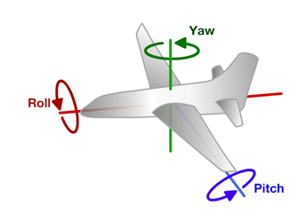
Principles of Operation (1)
An even number of motors provides lift and control in 6 dimensions
Spatial dimensions: x, y, z
Pitch: rotation around left-right (y) axis
Roll: rotation around the front-back (x) axis
Yaw: rotation around the top-bottom (z) axis
A flight computer operates a closed-loop controller to maintain stability and implement pilot commands.
Z
X
Y

Slide 45
Controlling Pitch
Pitch forward
More thrust to the rear
Less to the front
Pitch backward
Less thrust to the rear
More to the back

Slide 46
Controlling Roll
Pitch Left
More thrust to the right motor
Less to the left
Pitch Right
More thrust to the left motor
Less to the Right

Slide 47
Controlling Yaw
Rotate CCW
More thrust to the CCW motors
Less to the CW
Rotate CW
More thrust CW motors
Less to the CCW

Slide 48
Some Possible Configurations
Hexa +
Hexa x
“Plus”
“X”
Octa +
Octa x
“Octothorpe”
Y 6

Slide 49
Maintaining Stability
Multi-rotor aircraft are inherently unstable
Mismatched motor power (voltage variation, manufacturing variation in motors or props)
Variation in air currents and density.
Once perturbed, there’s no force acting on the aircraft to return it to equilibrium.

Slide 50
Maintaining Stability
Multi-rotor aircraft require a closed loop controller
Sensors detect aircraft movement and orientation
Controller adjusts the power to motors to maintain desired location and orientation
Multi-rotor aircraft use a few sensors to maintain stability
Accelerometers (absolute pitch and roll)
Gyroscopes (changes in pitch, roll, and yaw)
The flight computer implements the control algorithm
Usually a proportional, integral, derivative (PID) controller implemented in software.
We will talk more about this later.
With PID controllers for pitch, yaw, and roll multirotor aircraft can achieve stable flight.

Slide 51
Higher-order Navigation
Large multi-rotor aircraft can do more
Maintain geographic position
Maintain altitude
Follow an prescribed/pre-programmed path
More sensors required
Magnetometers (absolute yaw or heading)
GPS (absolute location and altitude)
Barometers (altitude)

Slide 52
Lab 3: Make all Your Hardware Work a.k.a Remote Controlled Motors

Slide 53
Demos
Show PWM signal changing duty cycle
Show flyback
Effect of diode
Show effect on power supply noise
Show filter on pwm line
Effect of resistor and capacitor on PWM
Show output of FET
Show affect of filter on power supply noise

Slide 54
The Inputs and Outputs
Gimbals – How they work and how to read them.
Brushed Motors – How they work and how to drive them.
The IMU – microcontroller and IMU communicate.
The serial display, LEDs, etc. – Communicating with the pilot.

Slide 55
Flyback
Opening S1 makes M1 an inductor
Drives up voltage M1-
Can destroy the switch
Can cause current to back to power supply.
Causes noise on power supply.
This is called “fly back”
Adding a diode relieves the problem.

Slide 56
Motor Driver
Pulse-width modulation (PWM)-controlled MOSFET
The microcontroller will drive the MOSFET
The MOSFET will drive current to the motor.

Slide 57
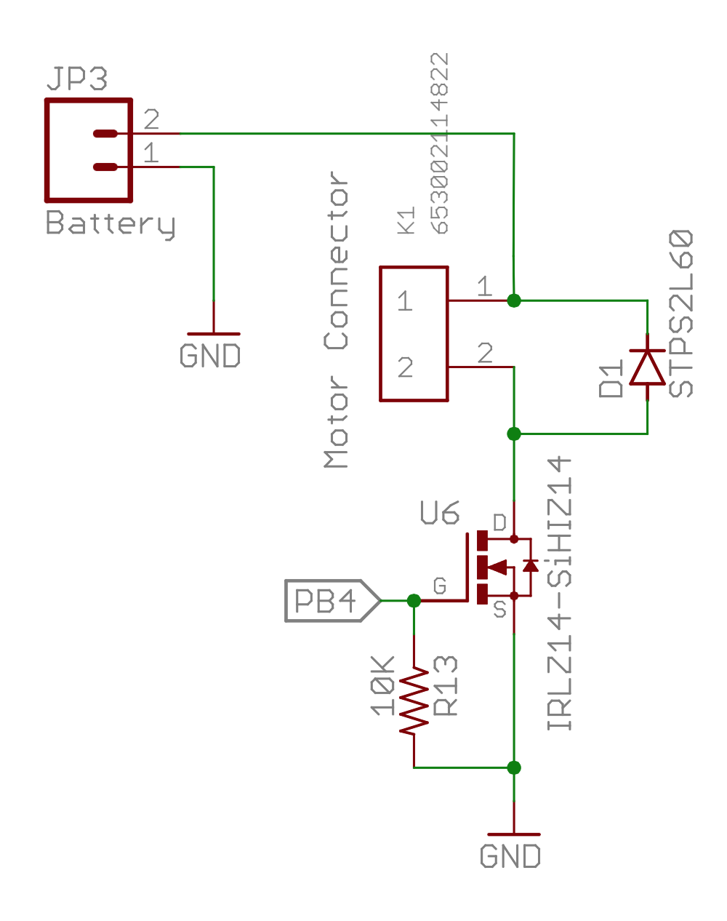
Our Motor Circuits

Slide 58
The Serial LCD Display

Slide 59
Display Text on the Remote
The LCD display on the remote is connected to the second serial port on the redboard
The LCD_library provides a nice interface for writing to it
Docs here: http://playground.arduino.cc/Code/SerLCD

